Slide 1

Noida Institute of Engineering and Technology, Greater Noida
Probability and Random Variable
Module 3
Subject Name: Statistics and Probability
Subject Code: BAS0303N
Dr. Jyoti Singh
Department of Mathematics
B. Tech 3rd Sem

Slide 2
Syllabus
Module 1: (Statistical Techniques-I)
Introduction: Measures of central tendency: Mean, Median, Mode, Standard deviation, Quartile deviation, Moment, Skewness, Kurtosis.
Module 2: (Statistical Techniques-II)
Curve Fitting, Method of least squares, fitting of straight lines, Fitting of second-degree parabola, Exponential curves, Correlation and Rank correlation, Linear regression, nonlinear regression and multiple linear regression.
Module 3: (Probability and Random Variable)
Random Variable: Definition of a Random Variable, Discrete Random Variable, Continuous Random Variable, Probability mass function, Probability Density Function, Distribution functions.
Multiple Random Variables: Joint density and distribution Function, Properties of Joint Distribution function, Marginal density Functions, Conditional Distribution and Density, Statistical Independence, Central Limit Theorem (Proof not expected).

Slide 3
Syllabus
Module 4: (Expectations and Probability Distribution)
Expectations of single Random Variable, Mean, Variance, Moment Generating Function, Binomial, Poisson, Normal, Exponential distribution.
Module 5: (Hypothesis Tests and Control Charts)
Testing a Hypothesis, Null hypothesis, Alternative hypothesis, Level of significance, Confidence limits, Test of significance of difference of means, Z-test, t-test and Chi-square test, F-test, One way ANOVA.
Statistical Quality Control (SQC), Control Charts, Control Charts for variables (Mean and Range Charts), Control Charts for Variables (p, np and C charts).

Slide 4
Branch Wise Application
Data Analysis
Artificial intelligence
Network and Traffic modeling

Slide 5
Course Objectives
The objective of this course is to familiarize the students with concepts of Probability and statistical techniques. It aims to equip the students with adequate Knowledge of statistics that will enable them in formulating Problems and solving problems analytically.
The students will learn:
Understand the concept of correlation, moments, skewness and kurtosis and curve fitting.
Apply the concept of hypothesis testing and statistical quality control to create control charts.
Remember the concept of probability to evaluate probability distributions.
Understand the concept of Mathematical Expectations and Probability Distribution.

Slide 6
Course Outcomes
CO1: Apply the concept of moments, skewness and kurtosis in relevant field.
CO2: Apply the concept of correlation, regression and curve fitting with real world problems.
CO3: Apply the concept of probability and random variable.
CO4: Apply the concept of Mathematical Expectations and Probability Distribution in real life problems.
CO5: Apply the concept of hypothesis testing and statistical quality control to create control charts.

Slide 7
Prerequisite (CO3)
Knowledge of Maths 1 B.Tech.
Knowledge of Maths 2 B.Tech.
Knowledge of Permutation and Combination.

Slide 8
Module Objectives (CO3)
A basic knowledge of random variables.
The student is able to reflect developed mathematical methods in probability and random variable.
Understand the concept of random variable.
4. To explore the key properties: such as PMF, PDF etc.

Slide 9
Topic Objective(CO3)
The random variable is very much helpful for making prediction. Estimates and predictions form an important part of research investigation. With the help of statistical methods, we make estimates for the further analysis.

Slide 10
Random Variable(CO3)
Definition: Random variable is a real-valued function whose domain is the sample space of a random experiment and codomain is a real number
Symbol : X
Example : An urn contains 5 red and 2 black balls. Two balls are randomly drawn. Let X represents the number of black balls. What are the possible values of X? Is X a random variable?
Solution:
Let B represents a black ball and R represents a red ball.
The two balls selected can be represented as BB, BR, RB, RR.
Thus, the possible values of X are 0, 1, and 2.
Yes, X is a random variable.

Slide 11
Random Variable(CO3)
There are two types of Random Variable.
Discrete Random variable: A random variable X , which can take only a finite number of values in an interval of the domain is called discrete random variable.
Example:
Number of mistakes in a page
Number of defective items in a lot
By tossing a coin 4 times, the number of Heads come up then the value of random variables are 0,1,2,3,4.
Continuous Random Variable: which variables can assume any value within interval is called continuous .
Example :
The heights of a group of individuals,
Weight of the students in a class etc.

Slide 12
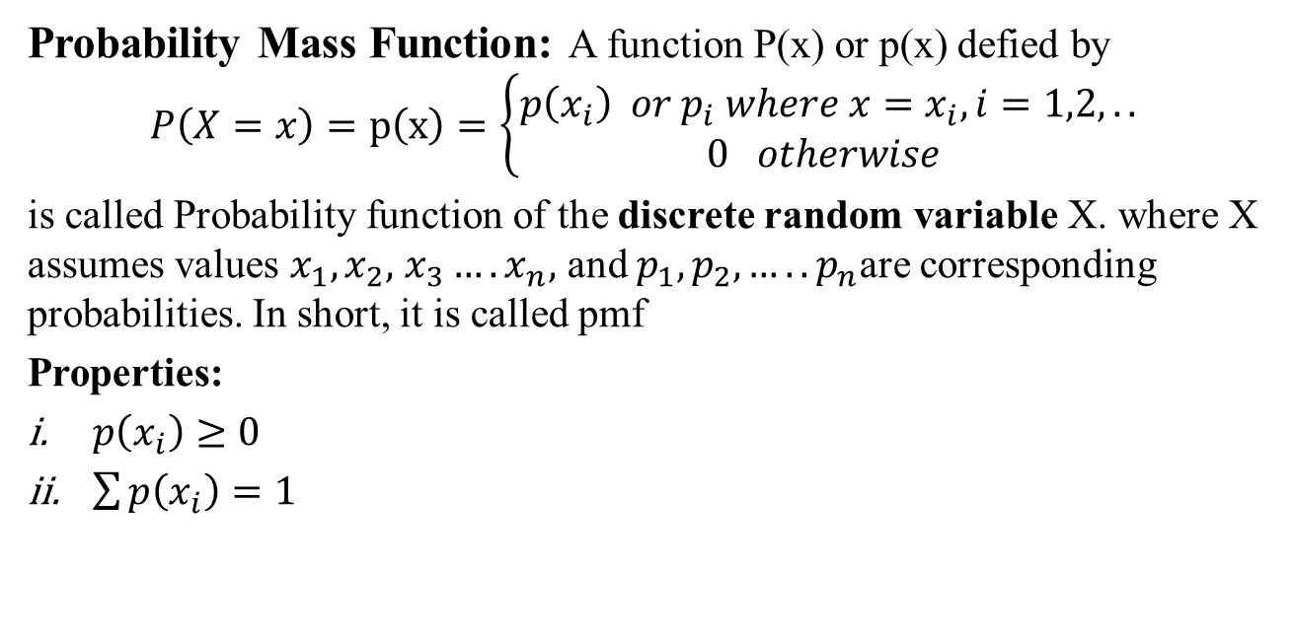
Probability Mass Function / probability distribution(CO3)
Probability Mass Function: A function P(x) or p(x) defied by
$$P\left(X=x\right)=p\left(x\right)=\left\{\begin{matrix}p\left(x_{i}\right) or p_{i} where x=x_{i},i=1,2,.. \\ 0 otherwise \end{matrix}\right.$$
is called Probability function of the discrete random variable X. where X assumes values $x_{1},x_{2},$ $x_{3}….x_{n},$ and $p_{1},p_{2}, …..p_{n}$are corresponding probabilities. In short, it is called pmf
Properties:
$p\left(x_{i}\right)≥0$
$\sum{p\left(x_{i}\right)=1}$

Slide 13
Probability distribution of a Random Variable(CO3)
Example: Is P(X) a Probability distribution ?
Solution: Yes, it is a Probability distribution because sum of all Probability (0.4+0.4+0.2= 1) is 1
Example:2 Find the probability distribution of number of heads in two tosses of a coin.
Solution: When one coin is tossed twice. the sample space is {HH,HT,TH,TT}
Let X represent the number of heads. X can take the value of 0, 1, or 2.
X | 0 | 1 | 2
P(X) | 0.4 | 0.4 | 0.2
X | 0 | 1 | 2
P(X) | 1/4 | 2/4 | 1/4

Slide 14
Daily Quiz (CO3)
Question 1: State which of the following are not the probability distribution of a random variable. Give reasons for your answer.
(i)
(ii)
(iii)
(iv)
X | 0 | 1 | 2
P (X) | 0.4 | 0.4 | 0.2
X | 0 | 1 | 2 | 3 | 4
P (X) | 0.1 | 0.5 | 0.2 | -0.1 | 0.3
X | -1 | 0 | 1
P (X) | 0.6 | 0.1 | 0.2
X | 3 | 2 | 1 | 0 | -1
P (X) | 0.3 | 0.4 | 0.1 | 0.3 | 0.05

Slide 15

Mean or Variance(CO3)
1.Mean of discrete random variables:
Mean $μ=\sum{p_{i}x_{i}}$
2.Variance of discrete random variables:
Variance =$\sum{p_{i}x_{i}^{2}−μ^{2} }$

Slide 16
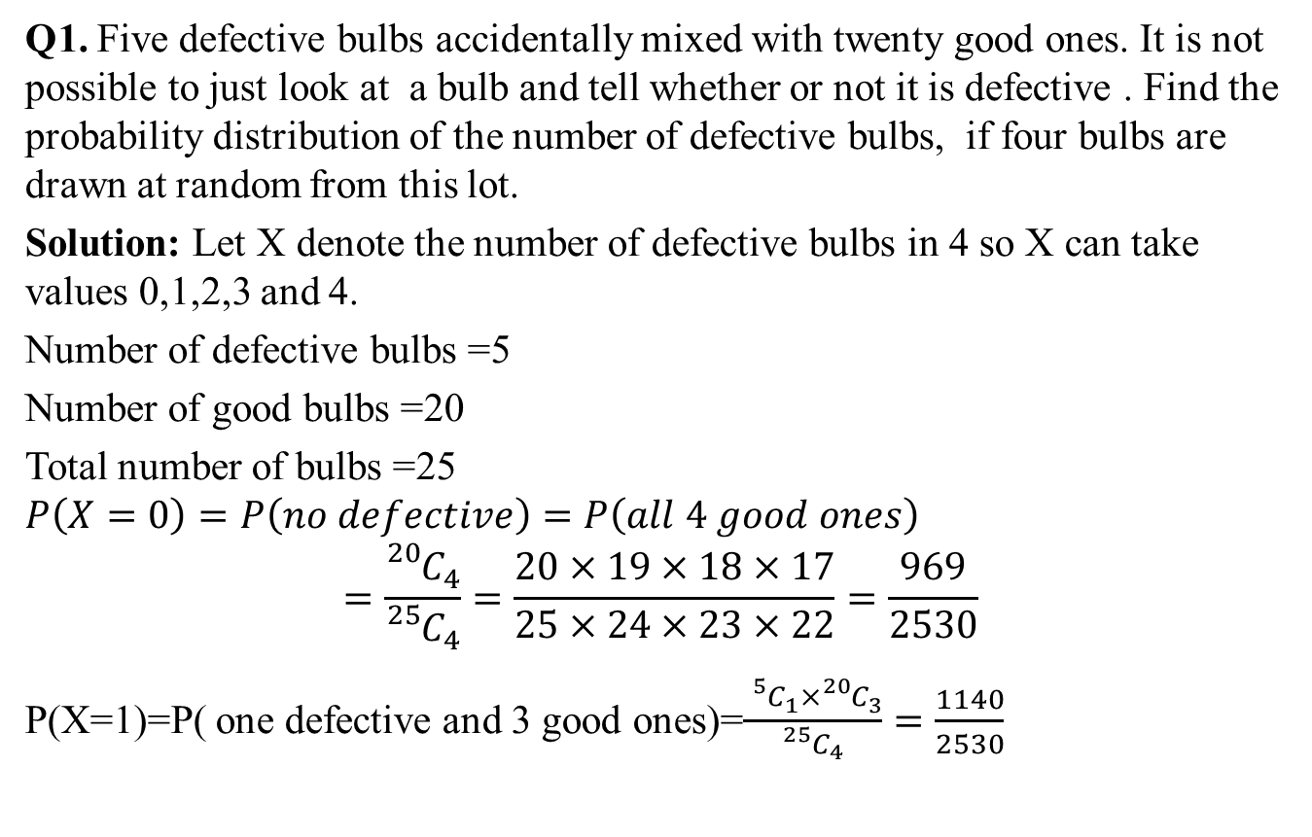
Example(CO3)
Q1. Five defective bulbs accidentally mixed with twenty good ones. It is not possible to just look at a bulb and tell whether or not it is defective . Find the probability distribution of the number of defective bulbs, if four bulbs are drawn at random from this lot.
Solution: Let X denote the number of defective bulbs in 4 so X can take values 0,1,2,3 and 4.
Number of defective bulbs =5
Number of good bulbs =20
Total number of bulbs =25
$$P\left(X=0\right)=P\left(no defective\right)=P\left(all 4 good ones\right)$$
$$=\frac{{}_{}^{20}{C_{4}}}{{}_{}^{25}{C_{4}}}=\frac{20×19×18×17}{25×24×23×22}=\frac{969}{2530}$$
P(X=1)=P( one defective and 3 good ones)=$\frac{{}_{}^{5}{C_{1}}×{}_{}^{20}{C_{3}}}{{}_{}^{25}{C_{4}}}=\frac{1140}{2530}$

Slide 17
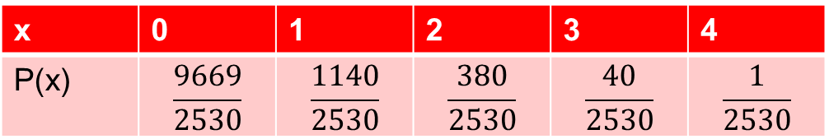

continue…(CO3)
P(X=2)=P( 2 defective and 2 good ones)=$\frac{{}_{}^{5}{C_{2}}×{}_{}^{20}{C_{2}}}{{}_{}^{25}{C_{4}}}=\frac{380}{2530}$
P(X=3)=P( 3 defective and 1 good ones)=$\frac{{}_{}^{5}{C_{3}}×{}_{}^{20}{C_{1}}}{{}_{}^{25}{C_{4}}}=\frac{40}{2530}$
P(X=4)=P( all 4 defectives)=$\frac{{}_{}^{5}{C_{4}}}{{}_{}^{25}{C_{4}}}=\frac{1}{2530}$
Therefore probability distribution of the random variable X is
x | 0 | 1 | 2 | 3 | 4
P(x) | $$\frac{9669}{2530}$$ | $$\frac{1140}{2530}$$ | $$\frac{380}{2530}$$ | $$\frac{40}{2530}$$ | $$\frac{1}{2530}$$

Slide 18
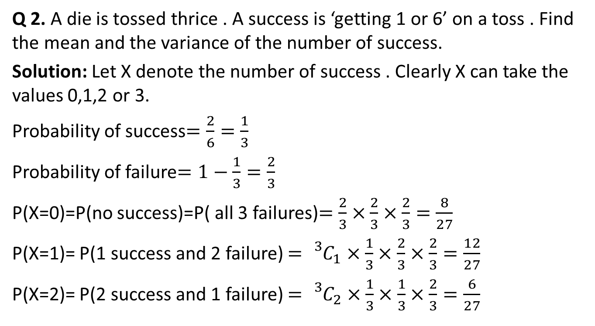
Example(CO3)
Q 2. A die is tossed thrice . A success is ‘getting 1 or 6’ on a toss . Find the mean and the variance of the number of success.
Solution: Let X denote the number of success . Clearly X can take the values 0,1,2 or 3.
Probability of success$=\frac{2}{6}=\frac{1}{3}$
Probability of failure$=1−\frac{1}{3}=\frac{2}{3}$
P(X=0)=P(no success)=P( all 3 failures)$=\frac{2}{3}×$ $\frac{2}{3}×\frac{2}{3}=\frac{8}{27}$
P(X=1)= P(1 success and 2 failure) $={}_{}^{3}{C_{1}×}\frac{1}{3}×$ $\frac{2}{3}×\frac{2}{3}=\frac{12}{27}$
P(X=2)= P(2 success and 1 failure) $={}_{}^{3}{C_{2}×}\frac{1}{3}×$ $\frac{1}{3}×\frac{2}{3}=\frac{6}{27}$

Slide 19
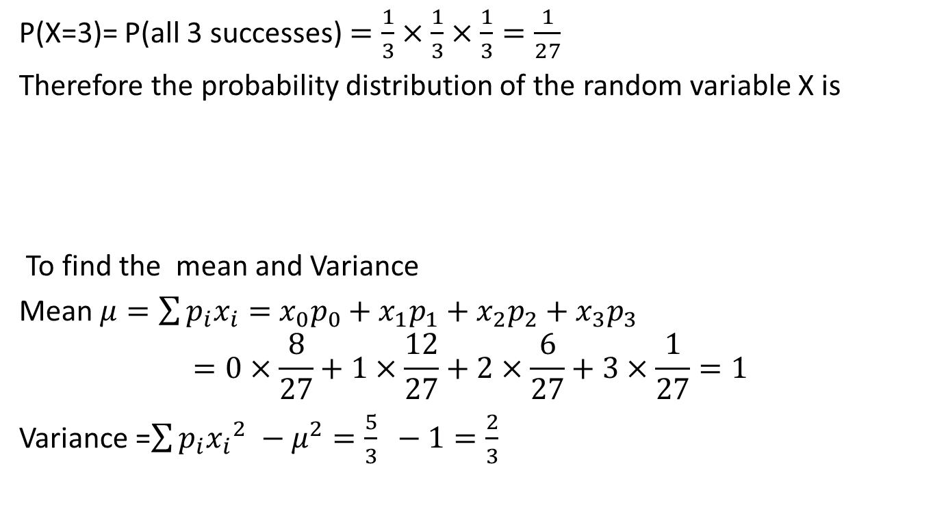
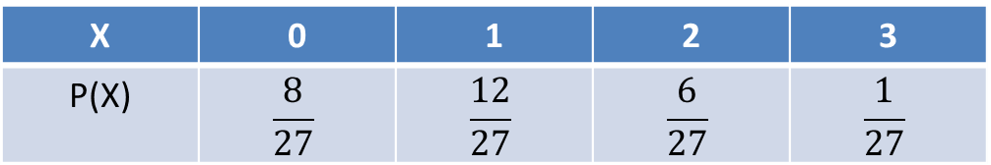
Continue…(CO3)
P(X=3)= P(all 3 successes) $=\frac{1}{3}×$ $\frac{1}{3}×\frac{1}{3}=\frac{1}{27}$
Therefore the probability distribution of the random variable X is
To find the mean and Variance
Mean $μ=\sum{p_{i}x_{i}=}$ ${x_{0}p_{0}+x}_{1}p_{1}+x_{2}p_{2}+x_{3}p_{3}$
$$=0×\frac{8}{27}+1×\frac{12}{27}+2×\frac{6}{27}+3×\frac{1}{27}=1$$
Variance =$\sum{p_{i}{x_{i}}_{}^{2}−μ^{2}=\frac{5}{3} −1=\frac{2}{3} }$
X | 0 | 1 | 2 | 3
P(X) | $$\frac{8}{27}$$ | $$\frac{12}{27}$$ | $$\frac{6}{27}$$ | $$\frac{1}{27}$$

Slide 20
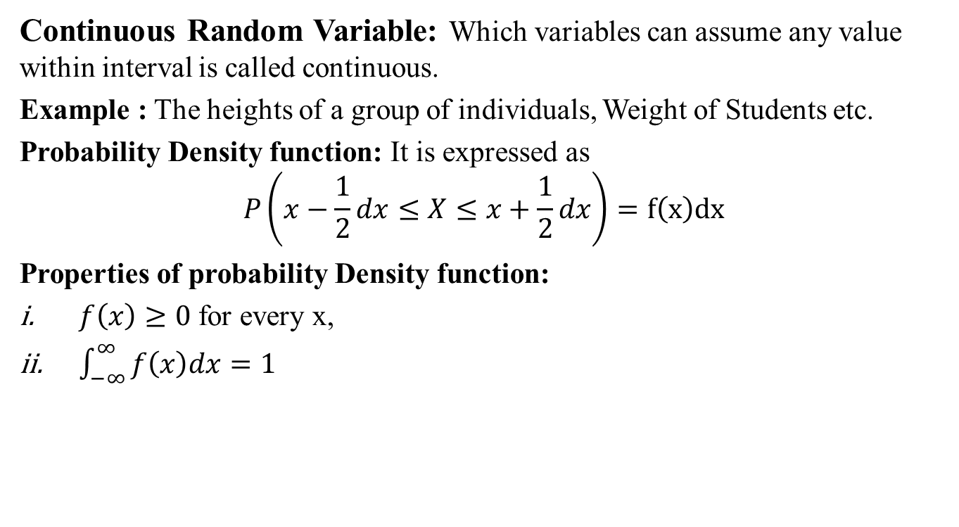
Continuous Random Variables(CO3)
Continuous Random Variable: Which variables can assume any value within interval is called continuous.
Example : The heights of a group of individuals, Weight of Students etc.
Probability Density function: It is expressed as
$$P\left(x−\frac{1}{2}dx≤X≤x+\frac{1}{2}dx\right)=f\left(x\right)dx$$
Properties of probability Density function:
$f\left(x\right)≥0$ for every x,
$\int_{−∞}^{∞}{f\left(x\right)dx=1}$

Slide 21
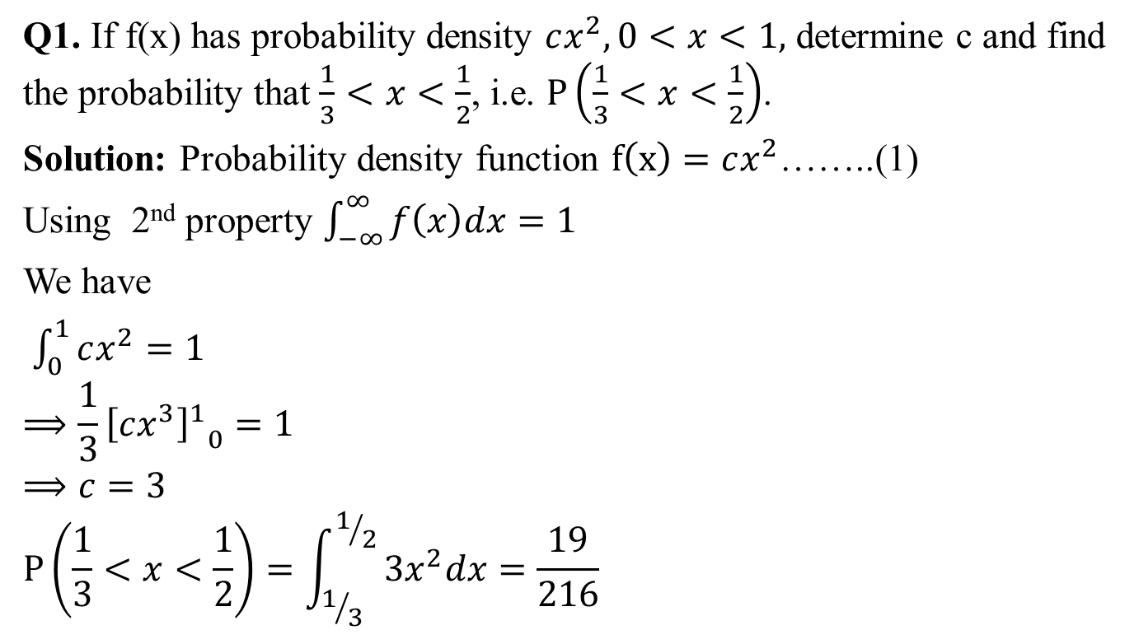
Probability Density function(CO3)
Q1. If f(x) has probability density $cx^{2},0<x<1,$ determine c and find the probability that $\frac{1}{3}<x<\frac{1}{2}$, i.e. $P\left(\frac{1}{3}<x<\frac{1}{2}\right)$.
Solution: Probability density function $f\left(x\right)=cx^{2}$……..(1)
Using 2nd property $\int_{−∞}^{∞}{f\left(x\right)dx=1}$
We have
$\int_{0}^{1}{cx^{2}=1}$
$$⟹\frac{1}{3}{{\left[cx^{3}\right]}^{1}}_{0}^{ }=1$$
$$⟹c=3$$
$$P\left(\frac{1}{3}<x<\frac{1}{2}\right)=\int_{1/3}^{1/2}{3x^{2}dx=\frac{19}{216}}$$

Slide 22
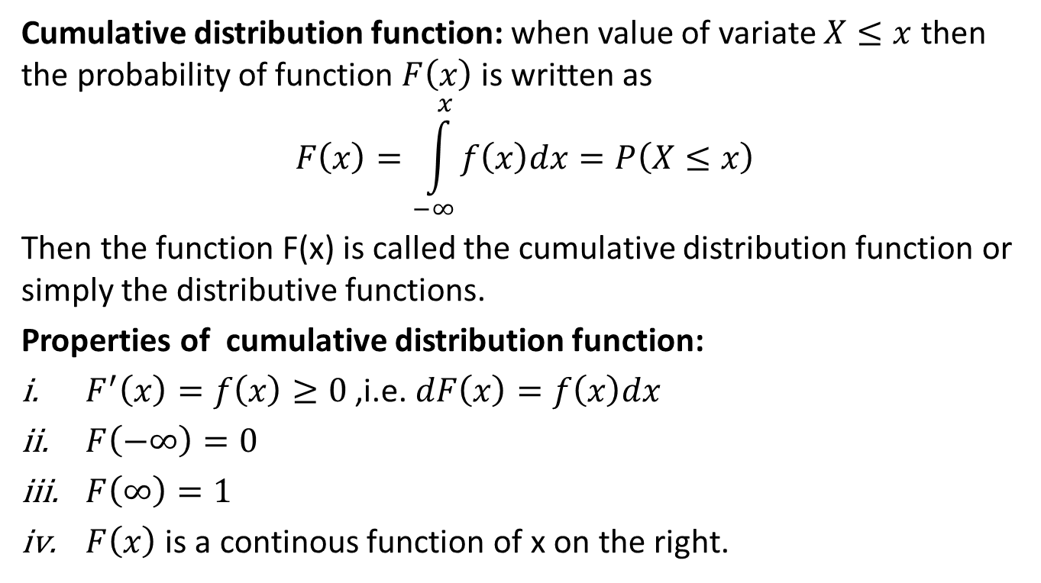
Cumulative distribution function(CO3)
Cumulative distribution function: when value of variate $X≤x$then the probability of function $F\left(x\right)$ is written as
$$F\left(x\right)=\int_{−∞}^{x}{f\left(x\right)dx}=P\left(X≤x\right)$$
Then the function F(x) is called the cumulative distribution function or simply the distributive functions.
Properties of cumulative distribution function:
$F^{′}\left(x\right)=f\left(x\right)≥0$ ,i.e. $dF\left(x\right)=f\left(x\right)dx$
$F\left(−∞\right)=0$
$F\left(∞\right)=1$
$F\left(x\right)$ is a continous function of x on the right.

Slide 23
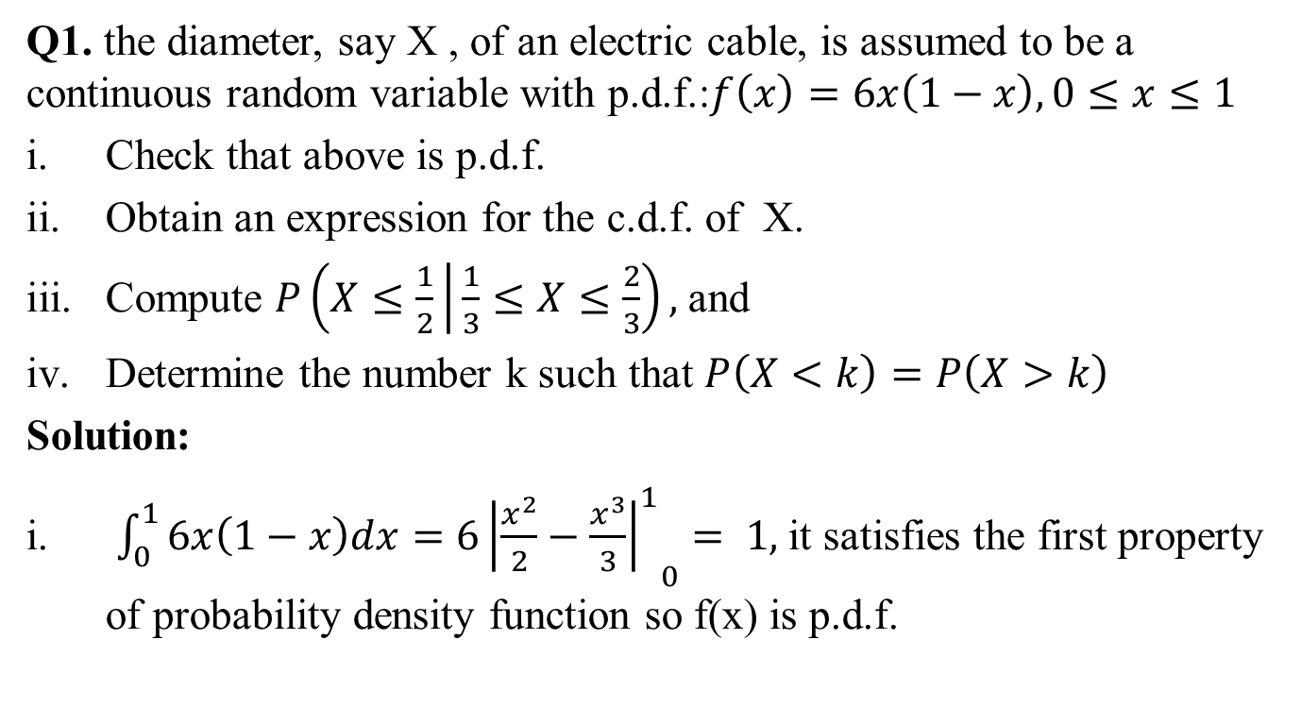
Cumulative distribution function(CO3)
Q1. the diameter, say X , of an electric cable, is assumed to be a continuous random variable with p.d.f.:$f\left(x\right)=6x\left(1−x\right),0≤x≤1$
Check that above is p.d.f.
Obtain an expression for the c.d.f. of X.
Compute $P\left(X≤\frac{1}{2} | \frac{1}{3}≤X≤\frac{2}{3}\right),$and
Determine the number k such that $P\left(X<k\right)=P\left(X>k\right)$
Solution:
$\int_{0}^{1}{6x\left(1−x\right)dx=6{{\left|\frac{x^{2}}{2}−\frac{x^{3}}{3}\right|}_{ }^{1}}_{0}}= 1,$it satisfies the first property of probability density function so f(x) is p.d.f.

Slide 24
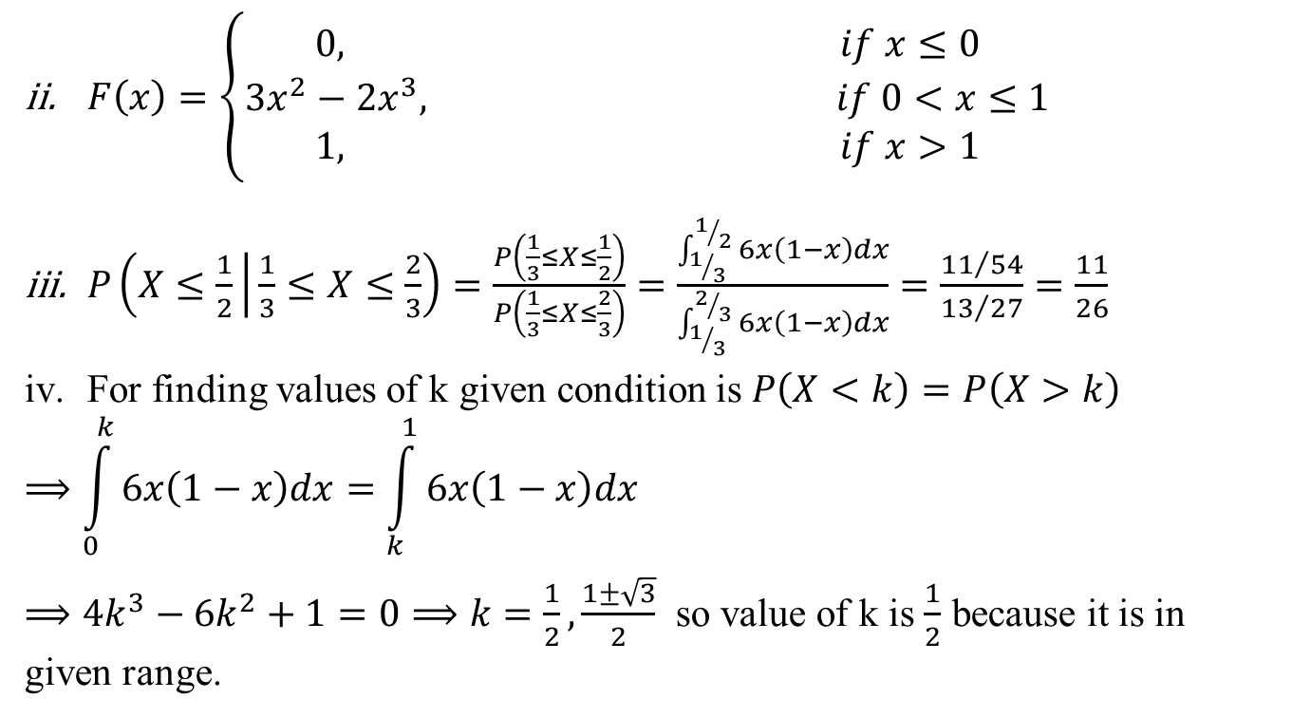
Cumulative distribution function(CO3)
$F\left(x\right)=\left\{\begin{matrix}0, if x≤0 \\ 3x^{2}−2x^{3}, if 0<x≤1 \\ 1, if x>1\end{matrix}\right.$
$P\left(X≤\frac{1}{2} | \frac{1}{3}≤X≤\frac{2}{3}\right)=\frac{P\left(\frac{1}{3}≤X≤\frac{1}{2}\right)}{P\left(\frac{1}{3}≤X≤\frac{2}{3}\right)}=\frac{\int_{1/3}^{1/2}{6x\left(1−x\right)dx}}{\int_{1/3}^{2/3}{6x\left(1−x\right)dx}}=\frac{{11}/{54}}{{13}/{27}}=\frac{11}{26}$
For finding values of k given condition is $P\left(X<k\right)=P\left(X>k\right)$
$$⟹\int_{0}^{k}{6x\left(1−x\right)dx=\int_{k}^{1}{6x\left(1−x\right)dx}}$$
$⟹4k^{3}−6k^{2}+1=0⟹k=\frac{1}{2},\frac{1±\sqrt{3}}{2}$ so value of k is $\frac{1}{2}$ because it is in given range.

Slide 25
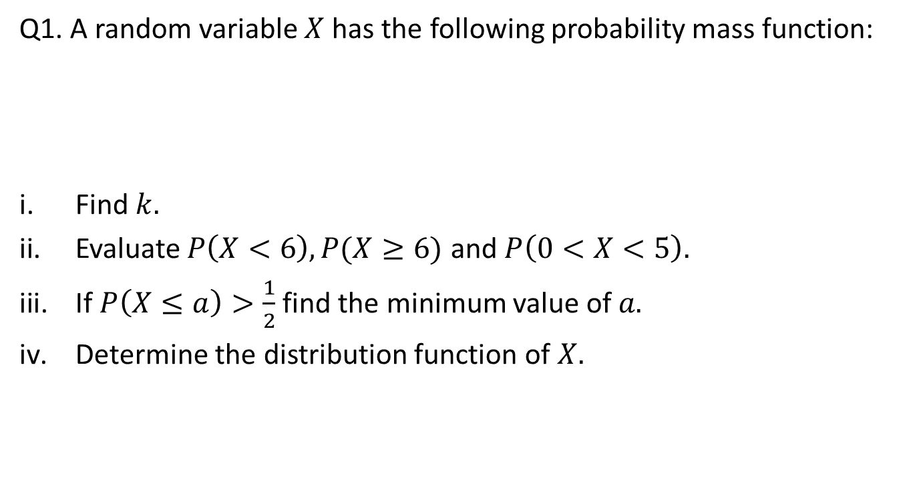
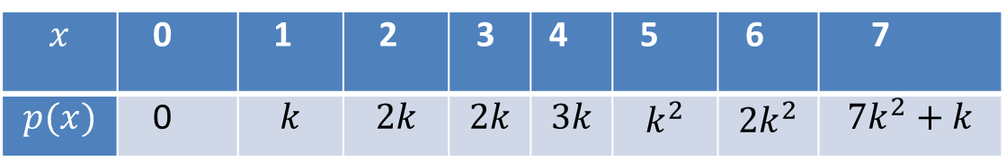
Daily Quiz(CO3)
Q1. A random variable $X$ has the following probability mass function:
Find $k.$
Evaluate $P\left(X<6\right),P(X≥6)$ and $P\left(0<X<5\right).$
If $P\left(X≤a\right)>\frac{1}{2}$ find the minimum value of $a.$
Determine the distribution function of $X.$
$$x$$ | 0 | 1 | 2 | 3 | 4 | 5 | 6 | 7
$$p(x)$$ | 0 | $$k$$ | $$2k$$ | $$2k$$ | $$3k$$ | $$k^{2}$$ | $${2k}^{2}$$ | $${7k}^{2}+k$$

Slide 26
Daily Quiz(CO3)
Q1. A random variable $X$ has the following probability mass function:
Find $k.$
Evaluate $P\left(X<6\right),P(X≥6)$ and $P\left(0<X<5\right).$
If $P\left(X≤a\right)>\frac{1}{2}$ find the minimum value of $a.$
Determine the distribution function of $X.$
$$x$$ | 0 | 1 | 2 | 3 | 4 | 5 | 6 | 7
$$p(x)$$ | 0 | $$k$$ | $$2k$$ | $$2k$$ | $$3k$$ | $$k^{2}$$ | $${2k}^{2}$$ | $${7k}^{2}+k$$

Slide 27
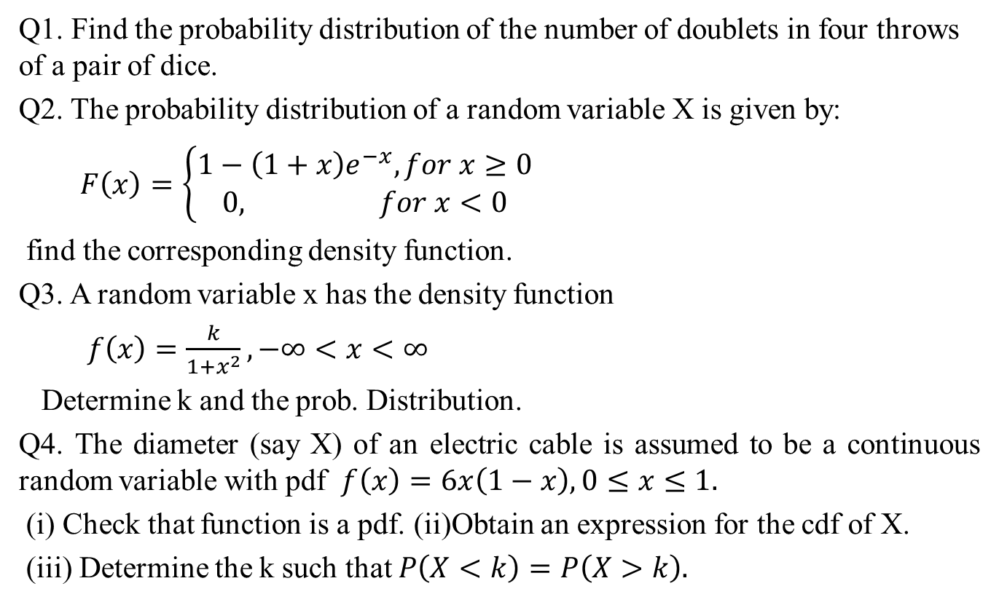
Weekly assignment(CO3)
Q1. Find the probability distribution of the number of doublets in four throws of a pair of dice.
Q2. The probability distribution of a random variable X is given by:
$F\left(x\right)=\left\{\begin{aligned}1−\left(1+x\right)e^{−x}, for x≥0 \\ 0, for x<0\end{aligned}\right.$
find the corresponding density function.
Q3. A random variable x has the density function
$f\left(x\right)=\frac{k}{1+x^{2}}, −∞<x<∞$
Determine k and the prob. Distribution.
Q4. The diameter (say X) of an electric cable is assumed to be a continuous random variable with pdf $f\left(x\right)=6x\left(1−x\right), 0≤x≤1.$
(i) Check that function is a pdf. (ii)Obtain an expression for the cdf of X.
(iii) Determine the k such that $P\left(X<k\right)=P\left(X>k\right).$

Slide 28
Recap(CO3)
Random Variables for one dimension.
Probability mass function
Probability Density function

Slide 29
Topic Objective(CO3)
Multivariable random variable:
In this lecture, we will extend the idea of single random variable in to the two dimensional variables.
Based on this idea , we will discuss the joint probability distribution, Marginal probability distribution and Conditional probability distribution.

Slide 30
Multiple random variable(CO3)
Two dimensional random variables(Multiple random variables):
Let S be the sample space of the random experiment. Let X and Y be two random variables, then the pair (X,Y) is called a bivariate random variable(or two dimensional random variable) if each of X and Y associates a real number with every outcomes.
If the random variables X and Y are both discrete then (X,Y) is called discrete bivariate random variable.
If the random variables X and Y are both continuous then (X,Y) is called continuous bivariate random variable.
For Example: Consider a random experiment of tossing a fair coin thrice. Let the random variable X denote the number of heads and Y denotes the number of tails that occurs in three tosses. Then, X takes the values 0,1,2,3 and Y takes the values 0,1,2,3.
Here (X,Y) is the discrete bivariate random variable.

Slide 31
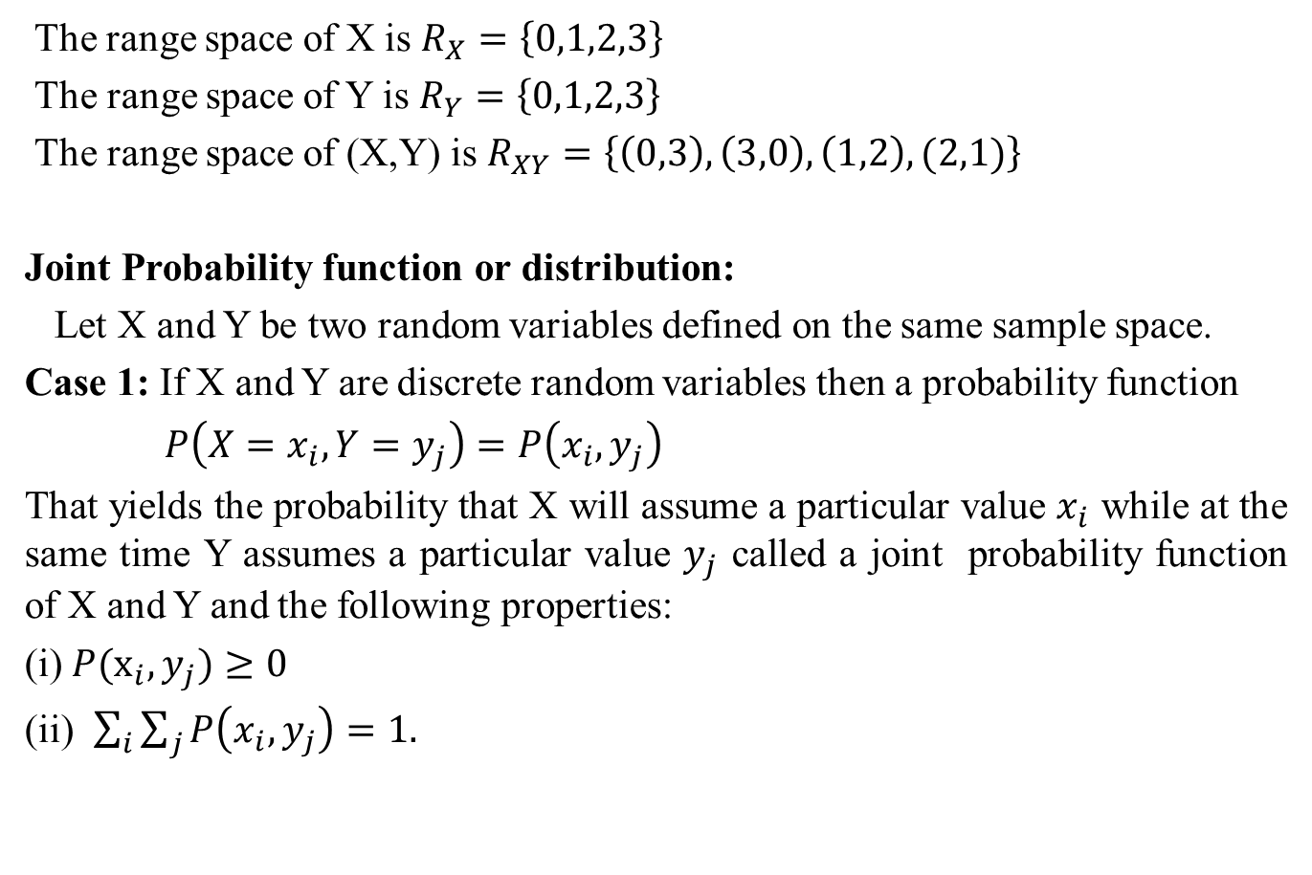
Joint Probability function(CO3)
The range space of X is $R_{X}=\left\{0,1,2,3\right\}$
The range space of Y is $R_{Y}=\left\{0,1,2,3\right\}$
The range space of (X,Y) is $R_{XY}=\left\{\left(0,3\right),\left(3,0\right),\left(1,2\right),(2,1)\right\}$
Joint Probability function or distribution:
Let X and Y be two random variables defined on the same sample space.
Case 1: If X and Y are discrete random variables then a probability function
$P\left(X=x_{i}, Y=y_{j}\right)=P\left(x_{i}, y_{j}\right)$
That yields the probability that X will assume a particular value $x_{i}$ while at the same time Y assumes a particular value $y_{j}$ called a joint probability function of X and Y and the following properties:
(i) $P(x_{i}, y_{j})≥0$
(ii) $\sum_{i}{\sum_{j}{P\left(x_{i}, y_{j}\right)=1.}}$

Slide 32
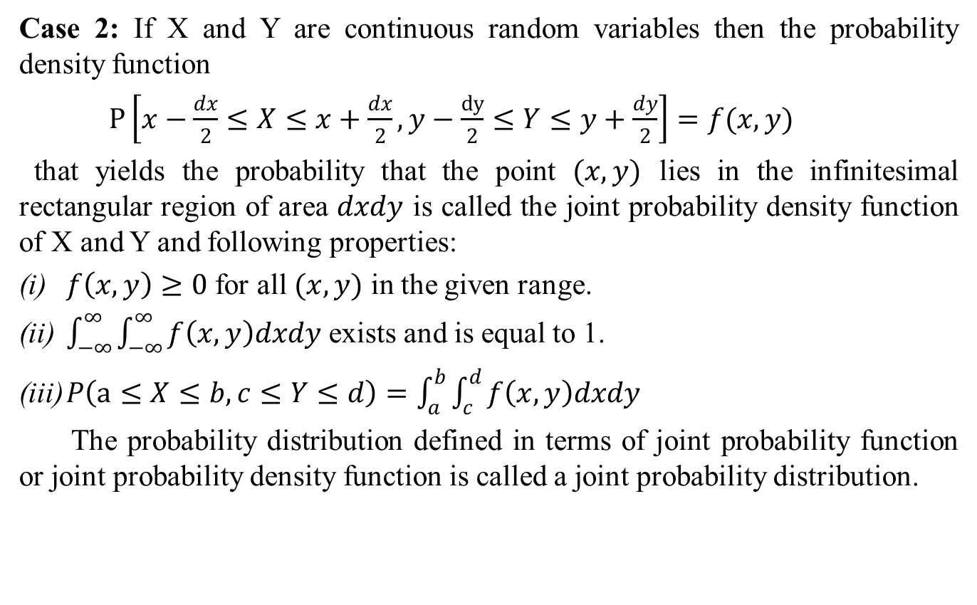
Joint Probability function(CO3)
Case 2: If X and Y are continuous random variables then the probability density function
$P\left[x−\frac{dx}{2}≤X≤x+\frac{dx}{2}, y−\frac{dy}{2}≤Y≤y+\frac{dy}{2}\right]=f(x, y)$
that yields the probability that the point $(x, y)$ lies in the infinitesimal rectangular region of area $dxdy$ is called the joint probability density function of X and Y and following properties:
$f\left(x, y\right)≥0$ for all $(x, y)$ in the given range.
$\int_{−∞}^{∞}{\int_{−∞}^{∞}{f\left(x, y\right)dxdy}}$ exists and is equal to 1.
$P\left(a≤X≤b, c≤Y≤d\right)=\int_{a}^{b}{\int_{c}^{d}{f\left(x, y\right)dxdy}}$
The probability distribution defined in terms of joint probability function or joint probability density function is called a joint probability distribution.

Slide 33
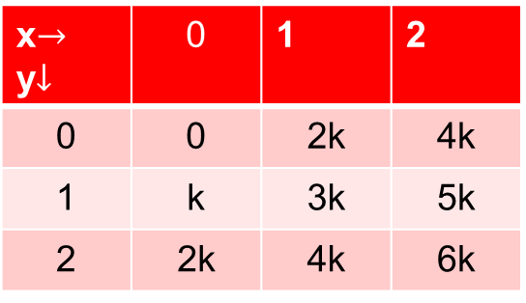
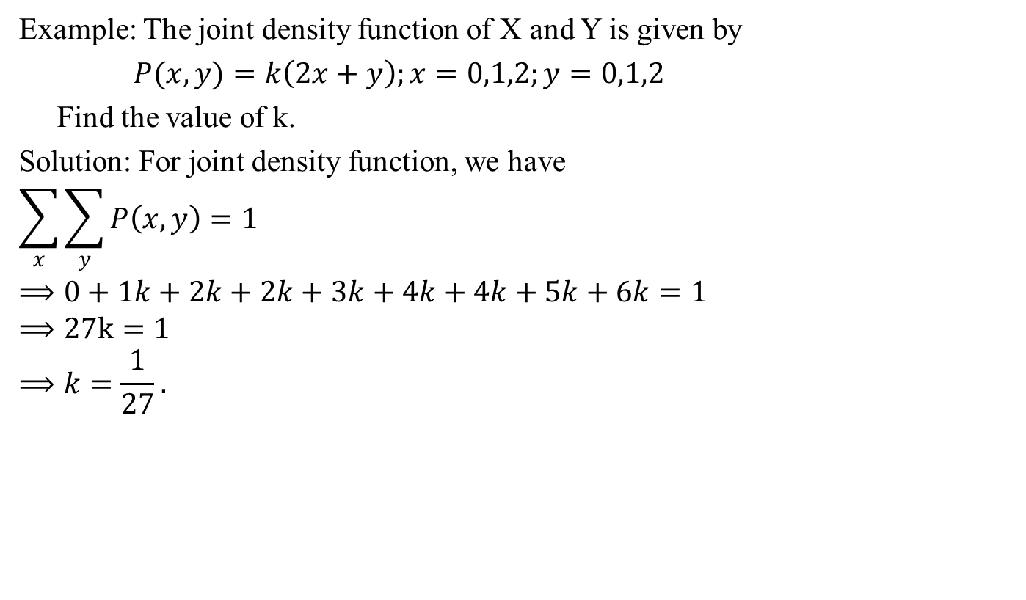
Joint Probability function(CO3)
Example: The joint density function of X and Y is given by
$P(x, y)=k\left(2x+y\right);x=0,1,2;y=0,1,2$
Find the value of k.
Solution: For joint density function, we have
$$\sum_{x}{\sum_{y}{P\left(x, y\right)=1}}$$
$$⟹0+1k+2k+2k+3k+4k+4k+5k+6k=1$$
$$⟹27k=1$$
$$⟹k=\frac{1}{27}.$$
x$→$ y$↓$ | 0 | 1 | 2
0 | 0 | 2k | 4k
1 | k | 3k | 5k
2 | 2k | 4k | 6k

Slide 34
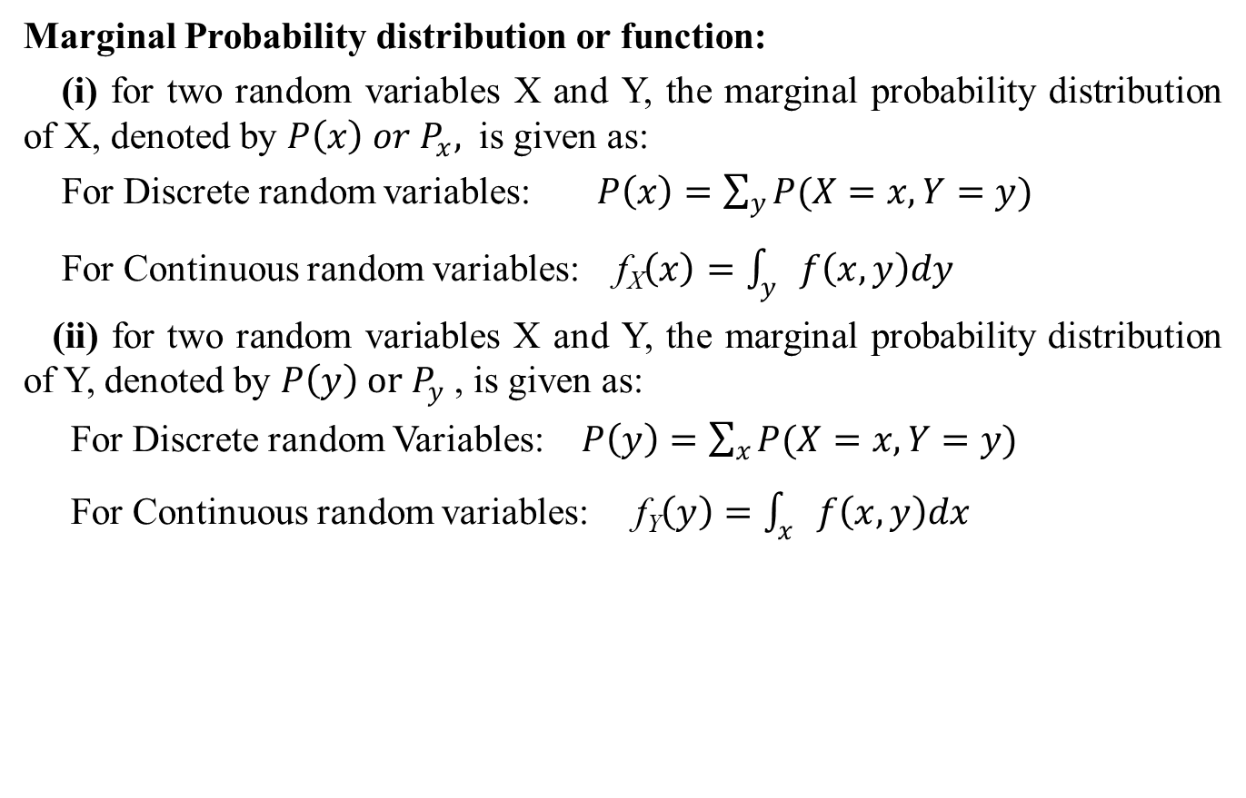
Marginal Probability distribution(CO3)
Marginal Probability distribution or function:
(i) for two random variables X and Y, the marginal probability distribution of X, denoted by $P\left(x\right) or P_{x},$ is given as:
For Discrete random variables: $P\left(x\right)=\sum_{y}{P(X=x, Y=y)}$
For Continuous random variables: f_{X}$\left(x\right)=\int_{y}{f\left(x, y\right)dy}$
(ii) for two random variables X and Y, the marginal probability distribution of Y, denoted by $P\left(y\right) or P_{y}$ , is given as:
For Discrete random Variables: $P\left(y\right)=\sum_{x}{P(X=x, Y=y)}$
For Continuous random variables: f_{Y}$\left(y\right)=\int_{x}{f\left(x,y\right)dx}$

Slide 35
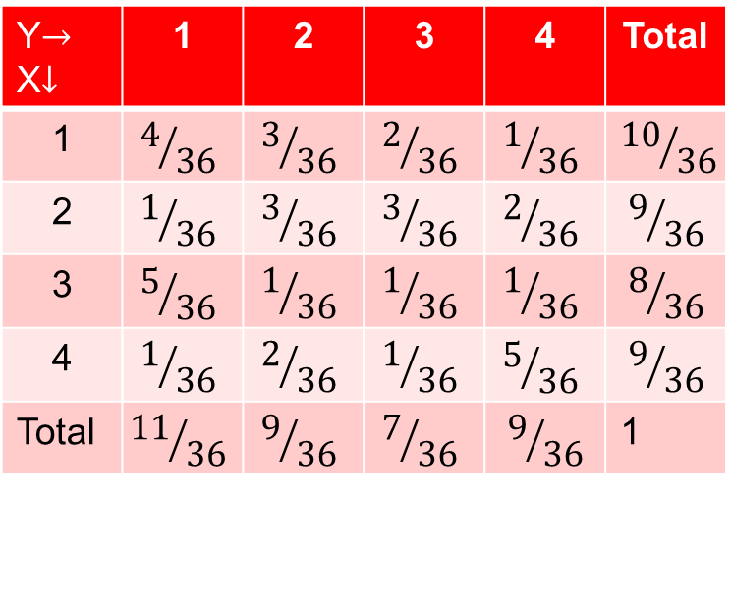
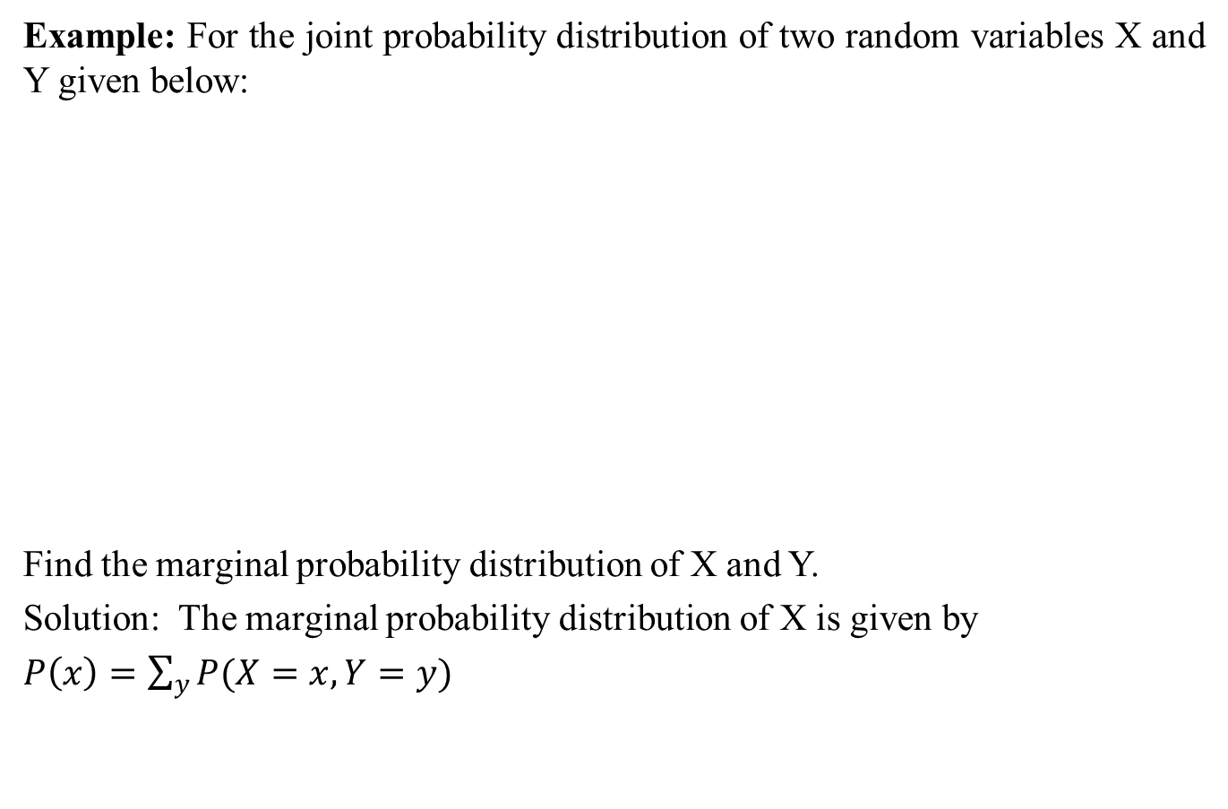
Marginal Probability distribution(CO3)
Example: For the joint probability distribution of two random variables X and Y given below:
Find the marginal probability distribution of X and Y.
Solution: The marginal probability distribution of X is given by
Y$→$ X$↓$ | 1 | 2 | 3 | 4 | Total
1 | $$4/{36}$$ | $$3/{36}$$ | $$2/{36}$$ | $$1/{36}$$ | $${10}/{36}$$
2 | $$1/{36}$$ | $$3/{36}$$ | $$3/{36}$$ | $$2/{36}$$ | $$9/{36}$$
3 | $$5/{36}$$ | $$1/{36}$$ | $$1/{36}$$ | $$1/{36}$$ | $$8/{36}$$
4 | $$1/{36}$$ | $$2/{36}$$ | $$1/{36}$$ | $$5/{36}$$ | $$9/{36}$$
Total | $${11}/{36}$$ | $$9/{36}$$ | $$7/{36}$$ | $$9/{36}$$ | 1

Slide 36
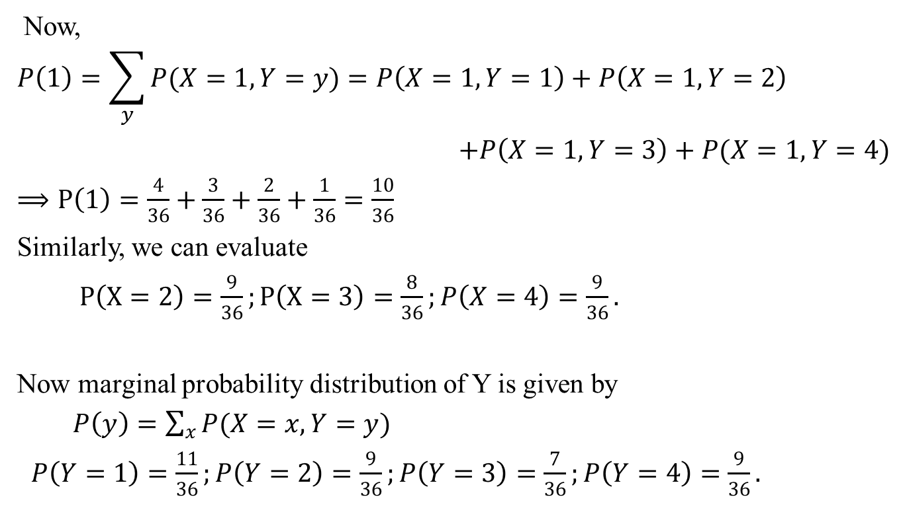
Marginal Probability distribution(CO3)
Now,
$$P\left(1\right)=\sum_{y}{P(X=1, Y=y)}=P\left(X=1,Y=1\right)+P\left(X=1,Y=2\right)$$
$+P\left(X=1,Y=3\right)+P(X=1,Y=4)$
$⟹P\left(1\right)=\frac{4}{36}+\frac{3}{36}+\frac{2}{36}+\frac{1}{36}=\frac{10}{36}$
Similarly, we can evaluate
$P\left(X=2\right)=\frac{9}{36};P\left(X=3\right)=\frac{8}{36};P\left(X=4\right)=\frac{9}{36}.$
Now marginal probability distribution of Y is given by
$P\left(y\right)=\sum_{x}{P(X=x, Y=y)}$
$P\left(Y=1\right)=\frac{11}{36};P\left(Y=2\right)=\frac{9}{36};P\left(Y=3\right)=\frac{7}{36};P\left(Y=4\right)=\frac{9}{36}.$

Slide 37
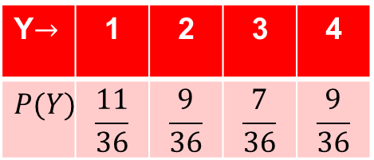
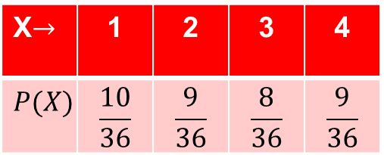
Marginal Probability distribution(CO3)
Hence, The marginal distribution of X
The marginal distribution of Y
X$→$ | 1 | 2 | 3 | 4
$$P(X)$$ | $$\frac{10}{36}$$ | $$\frac{9}{36}$$ | $$\frac{8}{36}$$ | $$\frac{9}{36}$$
Y$→$ | 1 | 2 | 3 | 4
$$P(Y)$$ | $$\frac{11}{36}$$ | $$\frac{9}{36}$$ | $$\frac{7}{36}$$ | $$\frac{9}{36}$$

Slide 38
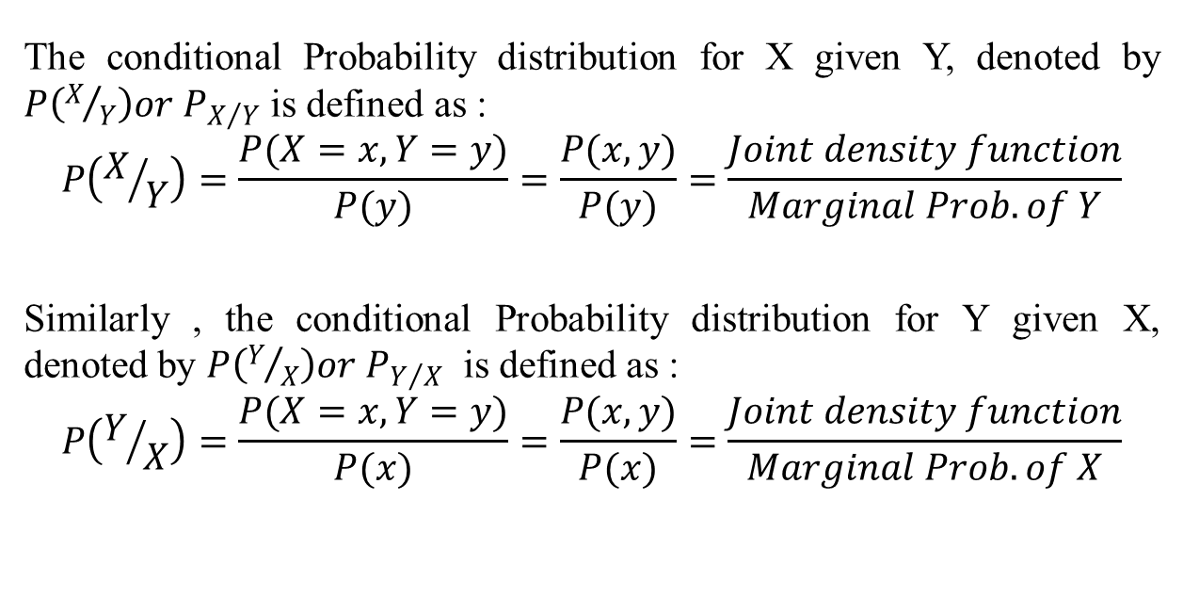
Conditional Probability distribution(CO3)
The conditional Probability distribution for X given Y, denoted by $P\left(X/Y\right)or P_{X/Y}$ is defined as :
$$P\left(X/Y\right)=\frac{P(X=x,Y=y)}{P(y)}=\frac{P(x,y)}{P(y)}=\frac{Joint density function}{Marginal Prob. of Y}$$
Similarly , the conditional Probability distribution for Y given X, denoted by $P\left(Y/X\right)or P_{Y/X}$ is defined as :
$$P\left(Y/X\right)=\frac{P(X=x,Y=y)}{P(x)}=\frac{P(x,y)}{P(x)}=\frac{Joint density function}{Marginal Prob. of X}$$

Slide 39
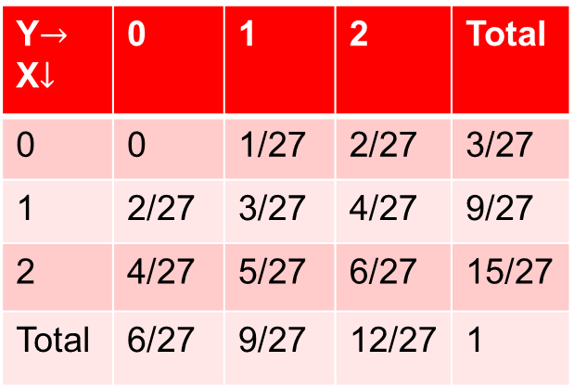
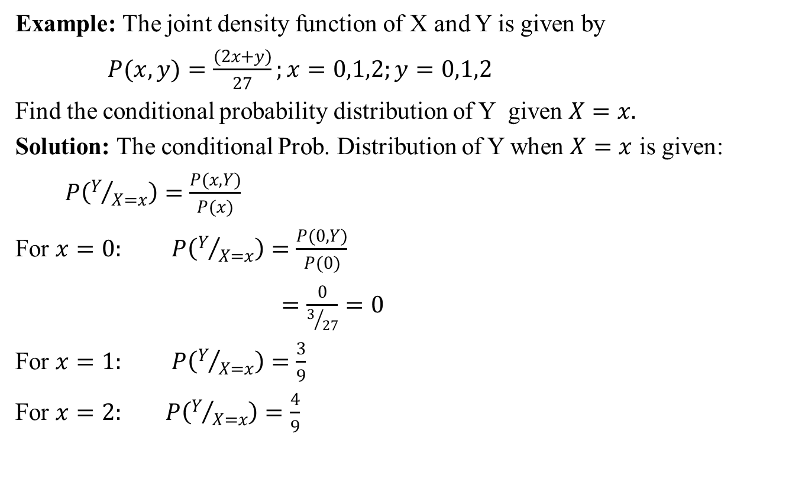
Conditional Probability distribution(CO3)
Example: The joint density function of X and Y is given by
$P(x, y)=\frac{(2x+y)}{27};x=0,1,2;y=0,1,2$
Find the conditional probability distribution of Y given $X=x.$
Solution: The conditional Prob. Distribution of Y when $X=x$ is given:
$P\left(Y/{X=x}\right)=\frac{P(x,Y)}{P(x)}$
For $x=0:$ $P\left(Y/{X=x}\right)=\frac{P(0,Y)}{P(0)}$
$=\frac{0}{3/{27}}=0$
For $x=1:$ $P\left(Y/{X=x}\right)=\frac{3}{9}$
For $x=2:$ $P\left(Y/{X=x}\right)=\frac{4}{9}$
Y$→$ X$↓$ | 0 | 1 | 2 | Total
0 | 0 | 1/27 | 2/27 | 3/27
1 | 2/27 | 3/27 | 4/27 | 9/27
2 | 4/27 | 5/27 | 6/27 | 15/27
Total | 6/27 | 9/27 | 12/27 | 1

Slide 40
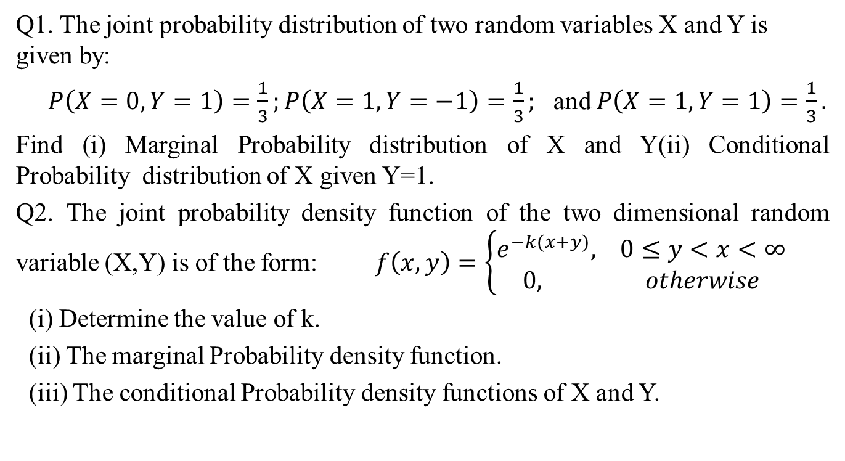
Daily Quiz(CO3)
Q1. The joint probability distribution of two random variables X and Y is given by:
$P\left(X=0,Y=1\right)=\frac{1}{3};P\left(X=1,Y=−1\right)=\frac{1}{3};$ and $P\left(X=1,Y=1\right)=\frac{1}{3}.$
Find (i) Marginal Probability distribution of X and Y(ii) Conditional Probability distribution of X given Y=1.
Q2. The joint probability density function of the two dimensional random variable (X,Y) is of the form: $f\left(x,y\right)=\left\{\begin{aligned}e^{−k(x+y)}, 0≤y<x<∞ \\ 0, otherwise\end{aligned}\right.$
(i) Determine the value of k.
(ii) The marginal Probability density function.
(iii) The conditional Probability density functions of X and Y.

Slide 41
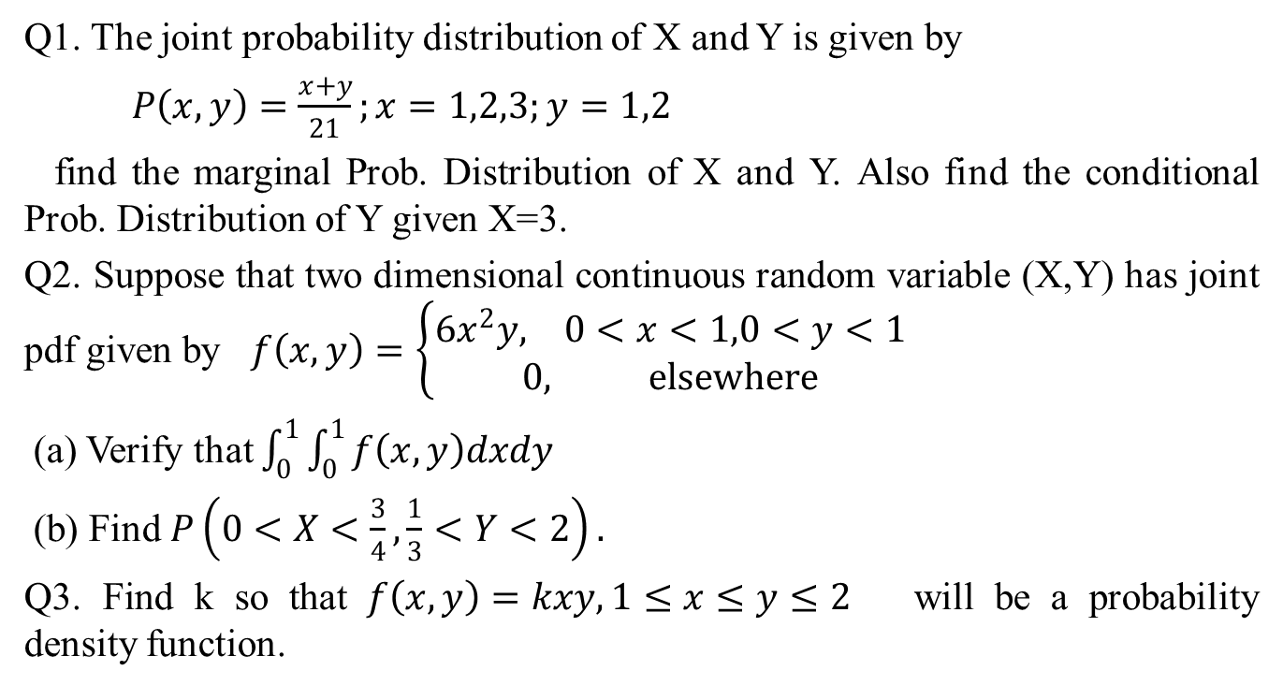
Weekly Assignment(CO3)
Q1. The joint probability distribution of X and Y is given by
$P\left(x,y\right)=\frac{x+y}{21};x=1,2,3;y=1,2$
find the marginal Prob. Distribution of X and Y. Also find the conditional Prob. Distribution of Y given X=3.
Q2. Suppose that two dimensional continuous random variable (X,Y) has joint pdf given by $f\left(x,y\right)=\left\{\begin{aligned}6x^{2}y, 0<x<1,0<y<1 \\ 0, elsewhere\end{aligned}\right.$
(a) Verify that $\int_{0}^{1}{\int_{0}^{1}{f\left(x,y\right)dxdy}}$
(b) Find $P\left(0<X<\frac{3}{4},\frac{1}{3}<Y<2\right).$
Q3. Find k so that $f\left(x,y\right)=kxy, 1≤x≤y≤2$ will be a probability density function.

Slide 42

Weekly Assignment(CO3)
Q4. A two dimensional random variable (X,Y) have a bivariate distribution given by:
$P\left(X=x,Y=y\right)=\frac{x^{2}+y}{32},$ for $x=0,1,2,3$ and $y=0,1.$ Find the marginal distribution o X and Y.

Slide 43
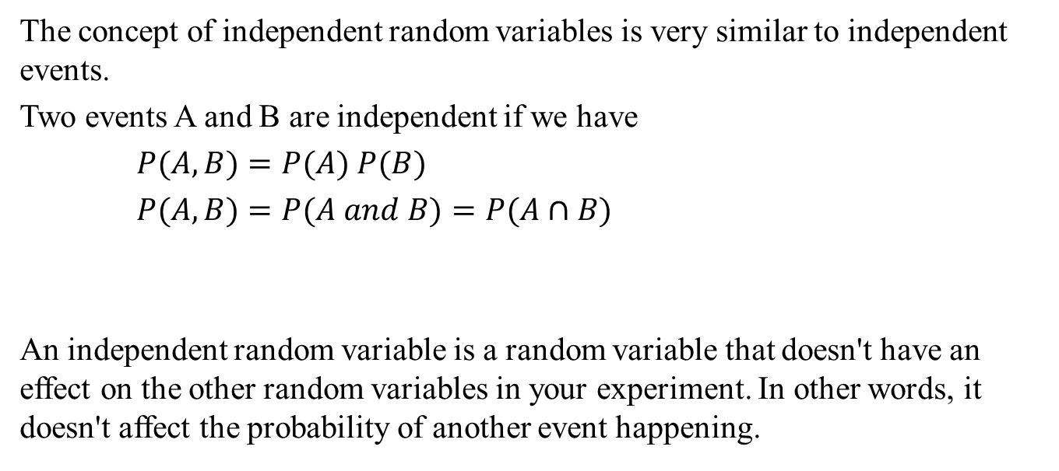
Statistical Independence(CO3)
The concept of independent random variables is very similar to independent events.
Two events A and B are independent if we have
$P(A,B)=P(A) P(B)$
$P(A,B)=P(A and B)=P(A∩B)$
An independent random variable is a random variable that doesn't have an effect on the other random variables in your experiment. In other words, it doesn't affect the probability of another event happening.

Slide 44
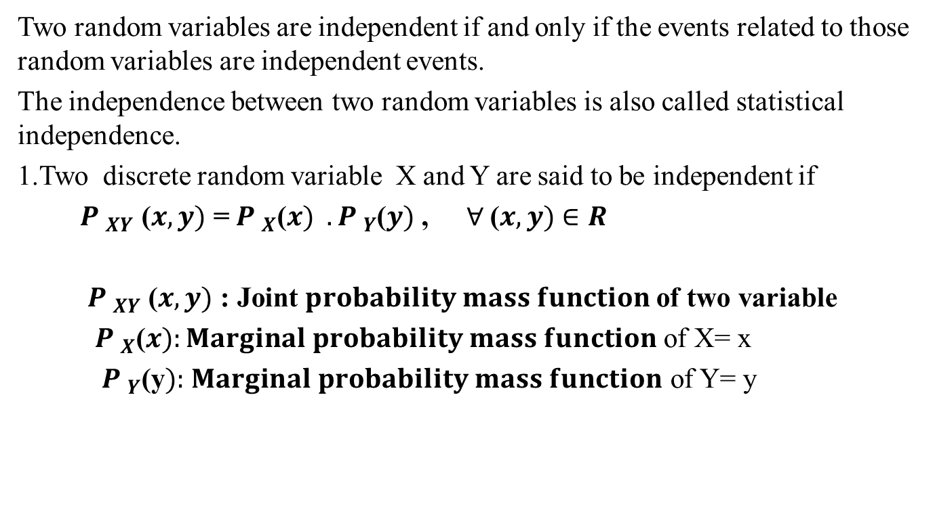
Statistical Independence(CO3)
Two random variables are independent if and only if the events related to those random variables are independent events.
The independence between two random variables is also called statistical independence.
1.Two discrete random variable X and Y are said to be independent if
${ P }_{XY}$ ($x,y)$ =${{ P }_{X}\text{(}x) . P }_{Y}$($y)$ ,$∀$($x,y)$ $∈R$
${ P }_{XY}$ ($x,y)$ : Joint $probability mass function$of two variable
${ P }_{X}$($x):Marginal probability mass function$ of X= x
${ P }_{Y}$(y$):$ $Marginal probability mass function$ of Y= y

Slide 45
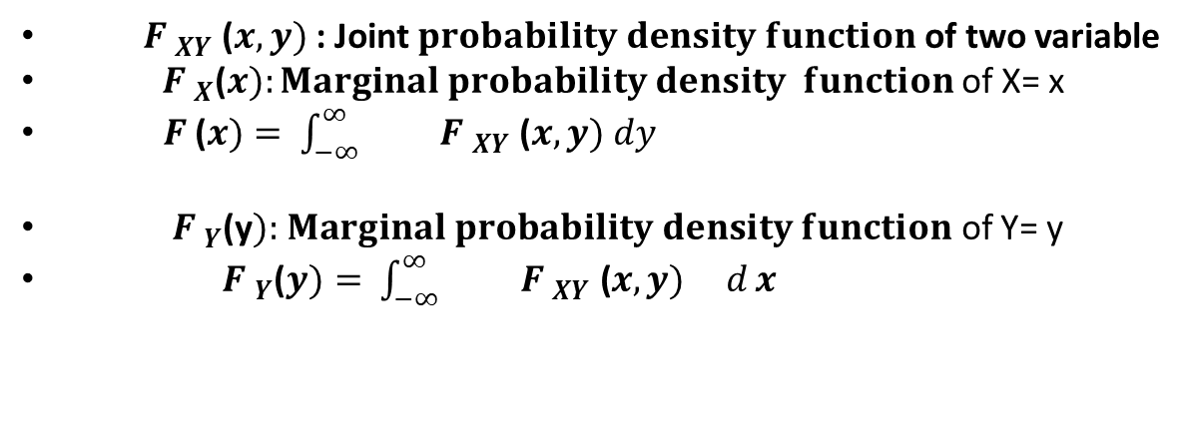
Statistical Independence(CO3)
Two random variables X and Y forming a continuous random vector, are
independent if and only if
${ F}_{XY}$ ($x,y)$ =${{ F }_{X}\text{(}x) F }_{Y}$($y)$ ,$∀$($x,y)$ $∈R$
${ F }_{XY}$ ($x,y)$ : Joint $probability density function$of two variable
${ F }_{X}$($x):Marginal probability density function$ of X= x
$F$ ($x)=$ $\int_{−∞}^{∞}{{ F }_{XY}\text{ (}x,y) dy}$
${ F }_{Y}$(y$):$ $Marginal probability density function$ of Y= y
${ F }_{Y}$($y)=$ $\int_{−∞}^{∞}{{ F }_{XY}\text{ (}x,y) d}x$

Slide 46
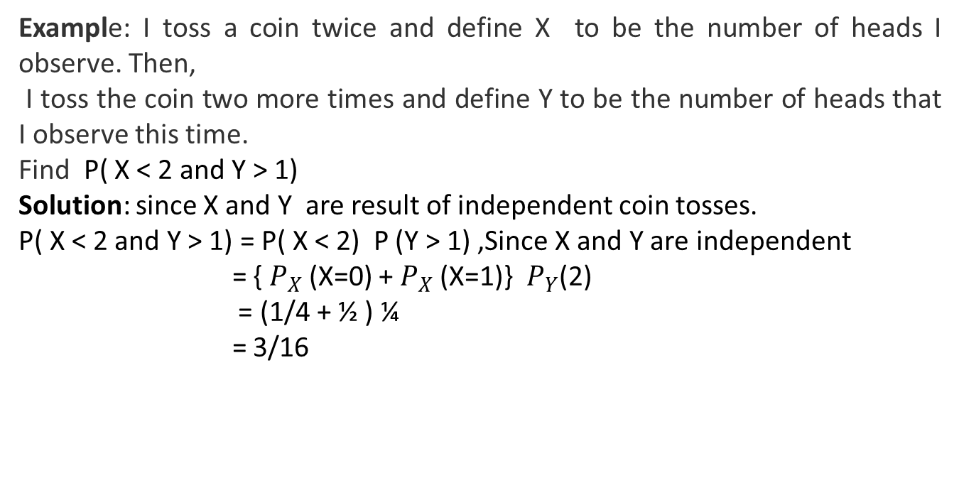
Statistical Independence(CO3)
Example: I toss a coin twice and define X to be the number of heads I observe. Then,
I toss the coin two more times and define Y to be the number of heads that I observe this time.
Find P( X < 2 and Y > 1)
Solution: since X and Y are result of independent coin tosses.
P( X < 2 and Y > 1) = P( X < 2) P (Y > 1) ,Since X and Y are independent
= { $P_{X}$(X=0) + $P_{X}$(X=1)} $P_{Y}$(2)
= (1/4 + ½ ) ¼
= 3/16

Slide 47
Central Limit Theorem (CO3)
The central limit theorem says that the sampling distribution of the mean will always be normally distributed, as long as the sample size is large enough. Regardless of whether the population has a normal, Poisson, binomial, or any other distribution, the sampling distribution of the mean will be normal.

Slide 48
Central Limit Theorem (CO3)
The central limit theorem (CLT) states that the distribution of sample means approximates a normal distribution as the sample size gets larger, regardless of the population's distribution.
A sufficiently large sample size can predict the characteristics of a population more accurately.
Sample sizes equal to or greater than 30 are often considered sufficient for the CLT to hold.
A key aspect of CLT is that the average of the sample means and standard deviations will equal the population mean and standard deviation.
CLT is useful in finance and investing when analyzing a large collection of securities to estimate portfolio distributions and traits for returns, risk, and correlation.

Slide 49
Recap(CO3)
Multi -variable probability distribution
Conditional probability distribution
Central limit theorem
Statistical independence

Slide 50
Assignment CO3)
Q1. Write central limit theorem.
Q2. Define statistical independence for discrete random variable
Q3. Define statistical independence for continuous random variable

Slide 51

MCQ (CO3)
Q1. Four person are chosen at random from a group containing 3 men, 2 women and 4 children then the probability that exactly two of them will be children is
$\frac{9}{21}$
$\frac{10}{21}$
$\frac{6}{21}$
None of these

Slide 52
MCQ (CO3)
Q 2. In a certain state, 25 percent of all cars emit excessive amounts of pollutants. If the probability is 0.99 that a car emitting excessive amounts will fail the state’s vehicular emission test, and the probability is 0.17 that a car not emitting excessive amounts of pollutants will nevertheless fail the test. What is the probability that a car that fails the test actually emits excessive amounts of pollutants?
0.60
0.70
0.66
None of these

Slide 53
MCQ (CO3)
Q3. A can hit a target 3 times in 5 shots, B 2 times in 5 shots and C 3 times in 4 shots. All of them fire one shot each simultaneously at the target. What is the probability that at least two shots hit-
0.60
0.62
0.63
0.50
Module II

Slide 54
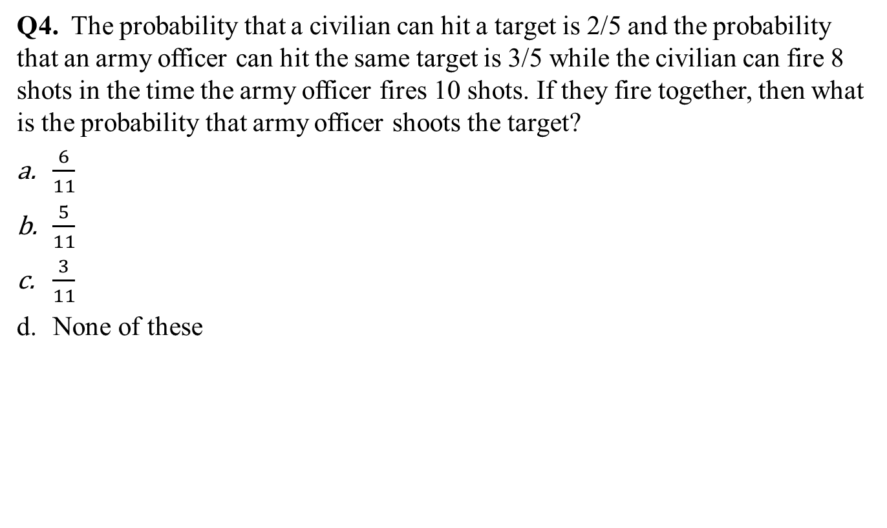
MCQ (CO3)
Q4. The probability that a civilian can hit a target is 2/5 and the probability that an army officer can hit the same target is 3/5 while the civilian can fire 8 shots in the time the army officer fires 10 shots. If they fire together, then what is the probability that army officer shoots the target?
$\frac{6}{11}$
$\frac{5}{11}$
$\frac{3}{11}$
None of these

Slide 55

MCQ (CO3)
Q5. The p.d.f $f(x)$ of a continuous random variable $x$ is defined by-
$f\left(x\right)=\left\{\begin{aligned}\frac{A}{x^{3}}, 5≤x≤10 \\ 0, otherwise\end{aligned}\right.$ . Then the value of $A$ is-
$\frac{100}{3}$
$\frac{200}{3}$
$\frac{50}{3}$
None of these

Slide 56
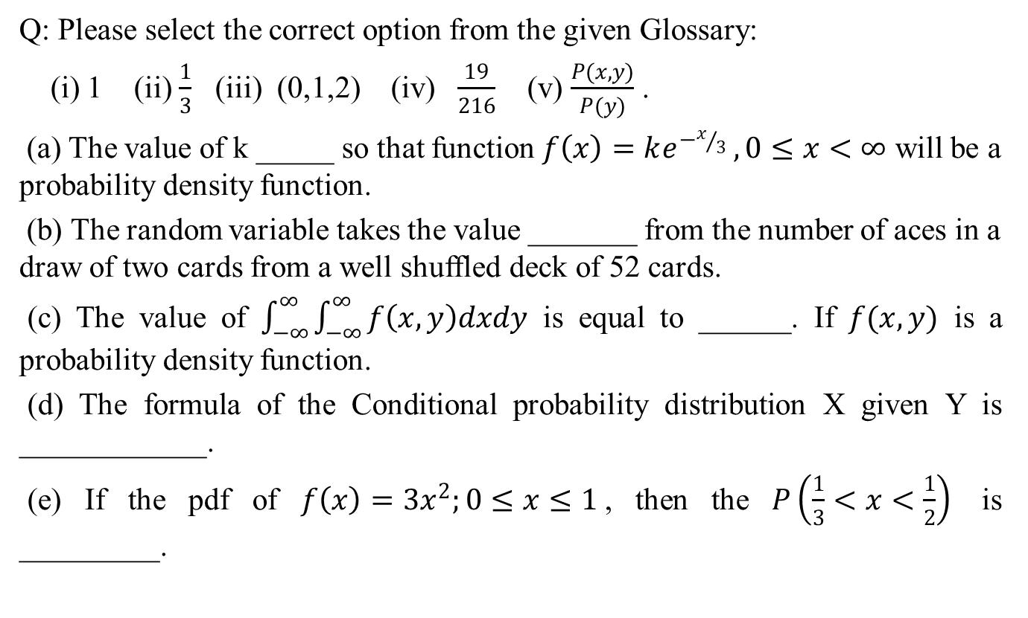
Glossary Questions (CO3)
Q: Please select the correct option from the given Glossary:
(i) 1 (ii) $\frac{1}{3}$ (iii) (0,1,2) (iv) $\frac{19}{216}$ (v) $\frac{P(x,y)}{P(y)}$ .
(a) The value of k _____ so that function $f\left(x\right)=ke^{−x/3} ,0≤x<∞$ will be a probability density function.
(b) The random variable takes the value _______ from the number of aces in a draw of two cards from a well shuffled deck of 52 cards.
(c) The value of $\int_{−∞}^{∞}{\int_{−∞}^{∞}{f\left(x,y\right)dxdy}}$ is equal to ______. If $f(x,y)$ is a probability density function.
(d) The formula of the Conditional probability distribution X given Y is ____________.
(e) If the pdf of $f\left(x\right)=3x^{2};0≤x≤1$, then the $P\left(\frac{1}{3}<x<\frac{1}{2}\right)$ is _________.

Slide 57
Glossary Questions (CO3)
Q: Please select the correct option from the given Glossary:
(i) 1 (ii) $\frac{1}{3}$ (iii) (0,1,2) (iv) $\frac{19}{216}$ (v) $\frac{P(x,y)}{P(y)}$ .
(a) The value of k _____ so that function $f\left(x\right)=ke^{−x/3} ,0≤x<∞$ will be a probability density function.
(b) The random variable takes the value _______ from the number of aces in a draw of two cards from a well shuffled deck of 52 cards.
(c) The value of $\int_{−∞}^{∞}{\int_{−∞}^{∞}{f\left(x,y\right)dxdy}}$ is equal to ______. If $f(x,y)$ is a probability density function.
(d) The formula of the Conditional probability distribution X given Y is ____________.
(e) If the pdf of $f\left(x\right)=3x^{2};0≤x≤1$, then the $P\left(\frac{1}{3}<x<\frac{1}{2}\right)$ is _________.

Slide 58
Expected University Questions (CO3)
Q1. Let X represents the difference between the number of heads and the number of tails obtained when a coin is tossed 6 times. What are possible values of X?
Q2. Find the probability distribution of
(i) number of heads in two tosses of a coin
(ii) number of tails in the simultaneous tosses of three coins
(iii) number of heads in four tosses of a coin
Q3 Find the probability distribution of the number of success in two tosses of die, where a success
is defined as
(i) number greater than 4

Slide 59
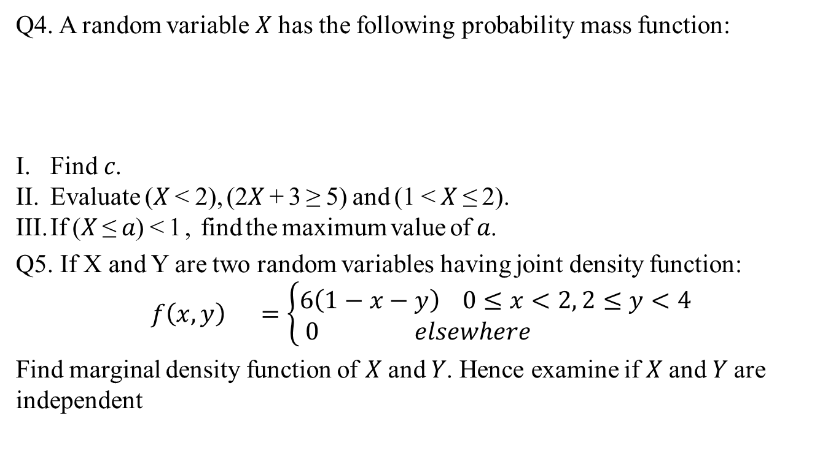
Expected University Questions (CO3)
Q4. A random variable 𝑋 has the following probability mass function:
Find 𝑐.
Evaluate (𝑋 < 2), (2𝑋 + 3 ≥ 5) and (1 < 𝑋 ≤ 2).
If (𝑋 ≤ 𝑎) < 1 , find the maximum value of 𝑎.
Q5. If X and Y are two random variables having joint density function:
$$f\left(x,y\right) =\left\{\begin{aligned}&6\left(1−x−y\right) 0≤x<2, 2≤y<4 \\ & 0 elsewhere\end{aligned}\right.$$
Find marginal density function of 𝑋 and 𝑌. Hence examine if 𝑋 and 𝑌 are independent
𝑥 | 0 | 1 | 2
𝑝(𝑥) | 3𝑐³ | 4c-10c² | 5𝑐 − 1

Slide 60
Old Question Papers
First Sessional Set-1 (CSE,IT,CS,ECE,IOT).docx
Second Sessional Set-2 (CSE,IT,CS,ECE,IOT).docx
Maths IV PUT.docx

Slide 61
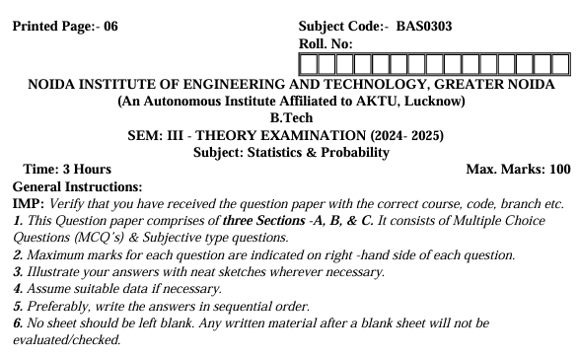
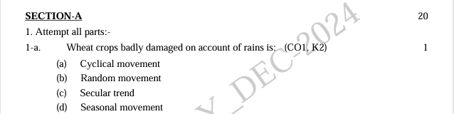
End Semester Question Paper

Slide 62
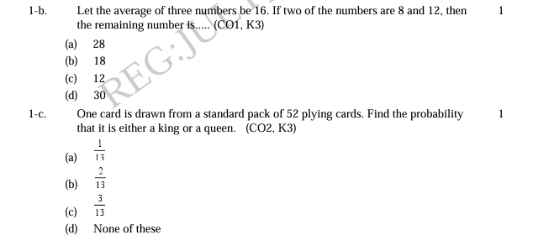
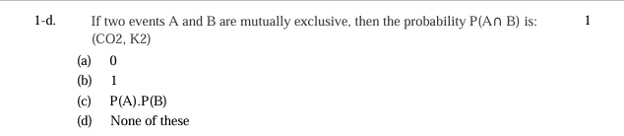
End Semester Question Paper

Slide 63
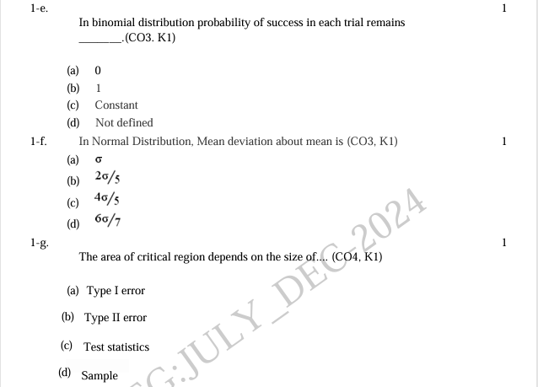
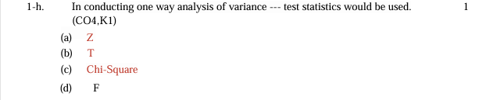
End Semester Question Paper

Slide 64
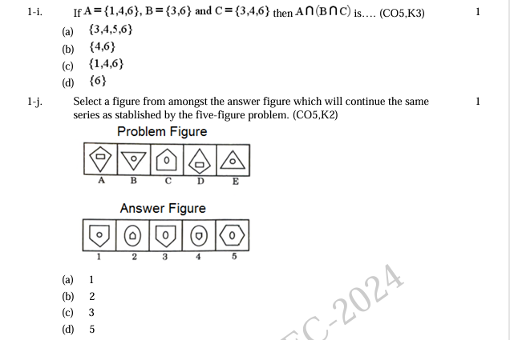
End Semester Question Paper

Slide 65
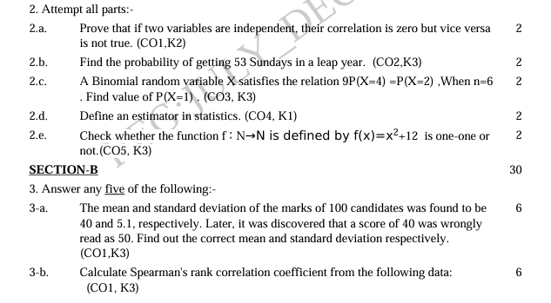
End Semester Question Paper

Slide 66
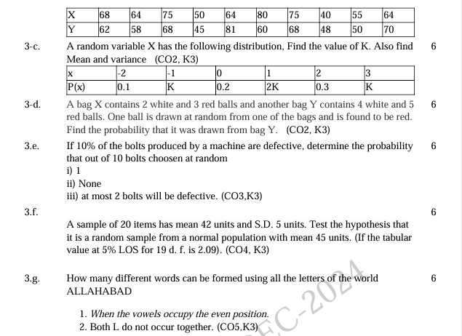
End Semester Question Paper

Slide 67

End Semester Question Paper

Slide 68

End Semester Question Paper

Slide 69

End Semester Question Paper

Slide 70

End Semester Question Paper

Slide 71

End Semester Question Paper

Slide 72
Expected Questions for University Exam(CO1)
Q1: An incomplete distribution of families according to their expenditure per week is given below. The median and mode for the distribution are Rs 25 and Rs 24 respectively. Calculate the missing frequencies.
Q2: The first four moments of a distribution about 2 are 1,2.5,5.5 and 16 respectively. Calculate the four moments about mean and about the origin.
Expenditure | 0-10 | 10-20 | 20-30 | 30-40 | 40-50
No. of families | 14 | ? | 27 | ? | 15

Slide 73

Expected Questions for University Exam(CO1)
Q3: Calculate the mean and standard deviation for the following data:
Q4: The first four moments of the distribution about the value 4 of the variable are -1.5, 17, -30, and 108. Find the moments about mean, $β_{1}$ and $β_{2}$.
Size of item | 6 | 7 | 8 | 9 | 10 | 11 | 12
Frequency | 3 | 6 | 9 | 13 | 8 | 5 | 4

Slide 74
References (CO3)
Text Books
N. P. Bali: A Textbook of Engineering Mathematics-IV, University Science Press.
H. K. Dass: Introduction to Engineering Mathematics, S. Chand.
S. Ross: A First Course in Probability, 6th Ed., Pearson Education India, 2002.
W. Feller, An Introduction to Probability Theory and its Applications, Vol. 1, 3rd Ed., Wiley, 1968.

Slide 75
References (CO3)
Reference Books
P. G. Hoel, S. C. Port and C. J. Stone, Introduction to Probability Theory, Universal Book Stall, 2003(Reprint).
R.K. Jain and S.R.K. Iyenger: Advance Engineering Mathematics; Narosa Publishing House, New Delhi.
J.N. Kapur: Mathematical Statistics; S. Chand & Sons Company Limited, New Delhi.
D.N.Elhance,V. Elhance & B.M. Aggarwal: Fundamentals of Statistics; Kitab Mahal Distributers, New Delhi.

Slide 76
Thank You

